Slide 1

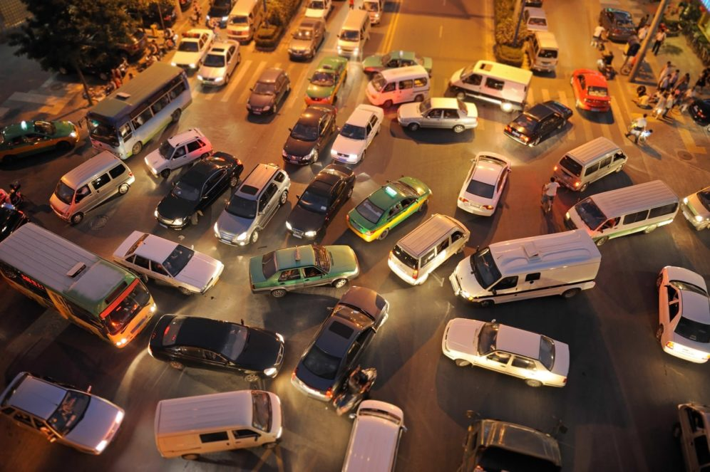

Vehicle count for traffic control
Nnamdi Okeke
Cesar Lucero
For the Introduction to Computer Vision Course (AAI-521-03)

Slide 2



Agenda
Problem Definition
EDA and Pre-processing
Modeling
Results and Findings

Slide 3




Introduction
This is presented as the final project for the Introduction to Computer Vision course as part of the Master of Applied Artificial Intelligence at the University of San Diego.

Slide 4

Problem Definition
Traffic Control

Slide 5
Problem Definition
Traffic Jams
Solution
Traffic lights sequences are static
Traffic and rush hours
Big events
Emergency vehicles
Smart traffic lights adequation
Detection of different types of vehicles
Assessing priority for emergency vehicles
Allowing more greenlights when traffic is heavier in a certain direction.

Slide 6
EDA And Pre-processing
Traffic Control

Slide 7
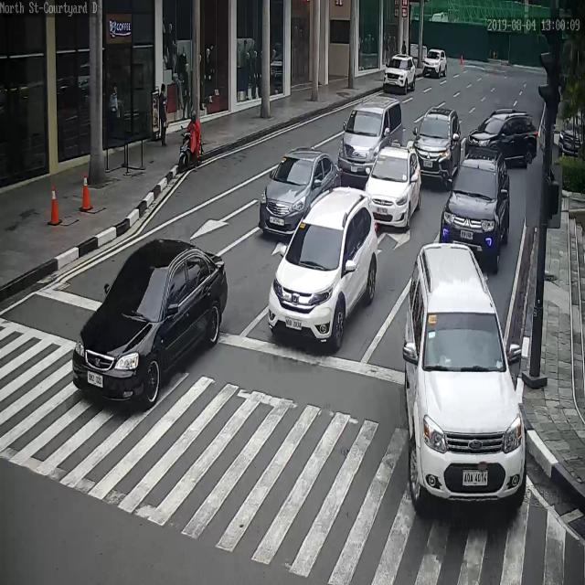
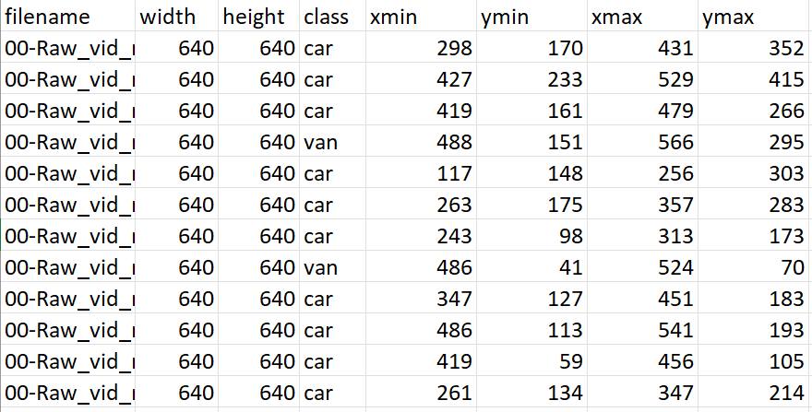
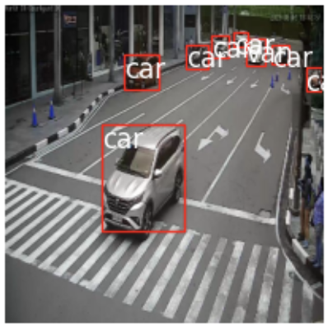
Vehicle and Traffic Dataset
City Intersection | Computer Vision dataset.
Testing, Training and Validation image datasets 1899 count.
Bounding Boxes annotations
Raw image
Bounding Boxes annotations
Bounding Boxes

Slide 8
Modeling
SSD Model

Slide 9
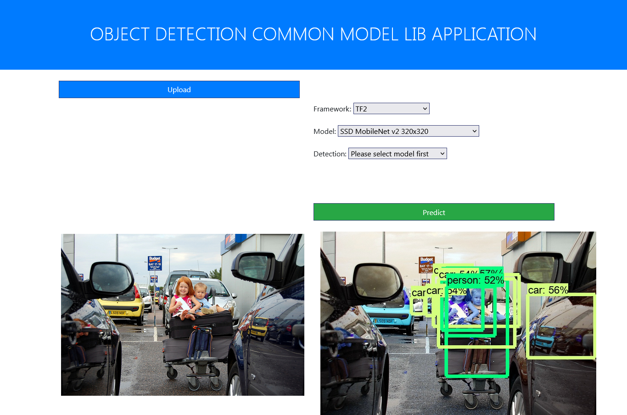
Single Shot Detection
SSD is popular for its speed and accuracy.
Requires only a single pass through the neural network
Interpretation of various scales (depth changes)

Slide 10
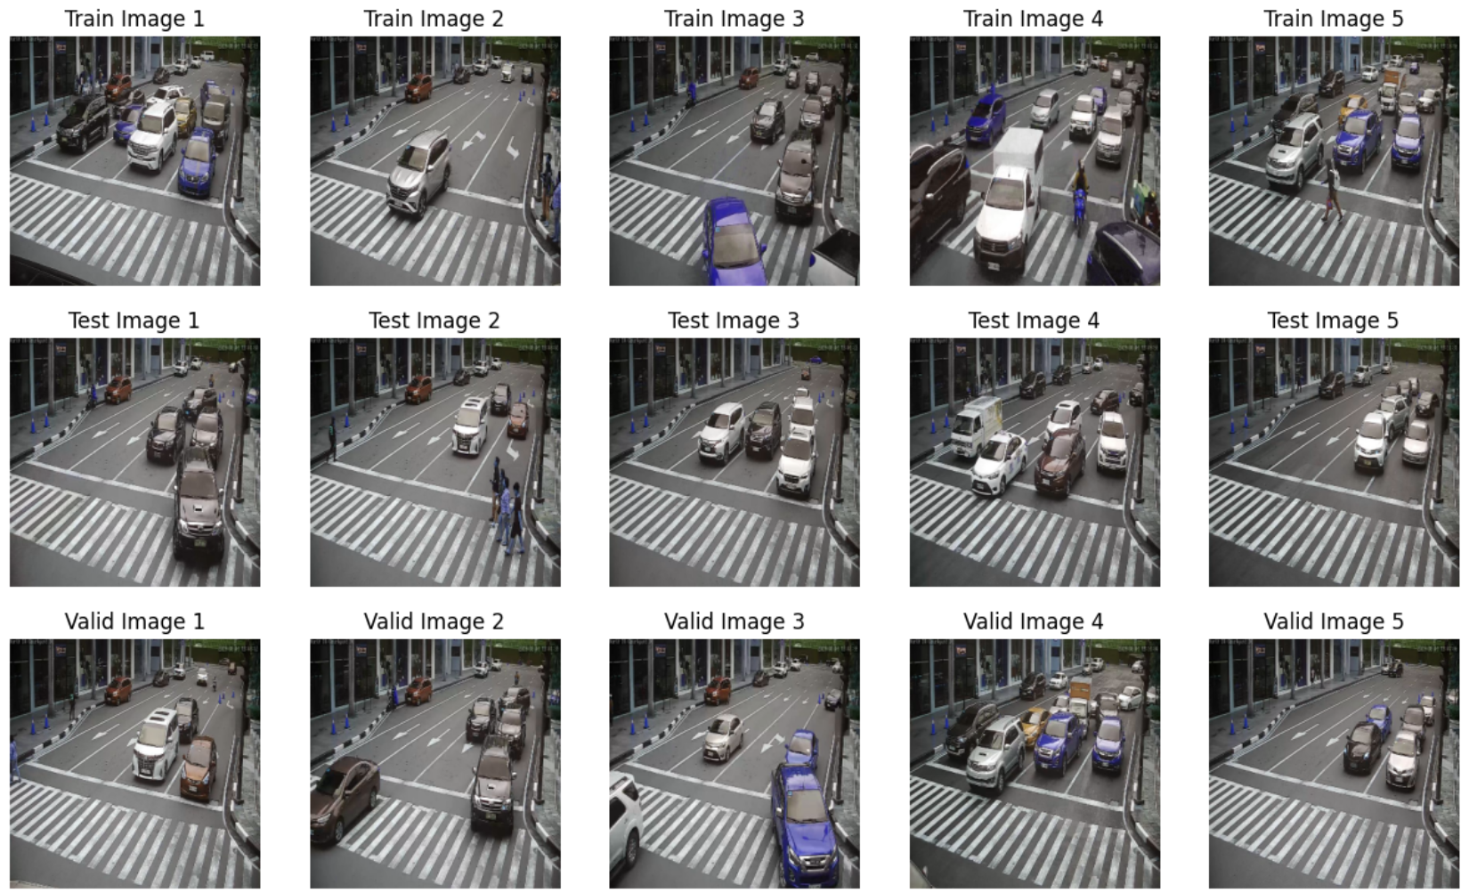
Training
Label mapping
Cars, Vans, Motorcycles, etc…
Training images.
Bounding box incorporation for training images.
TensorFlow Record files generation and training.
Preprocessed Images

Slide 11
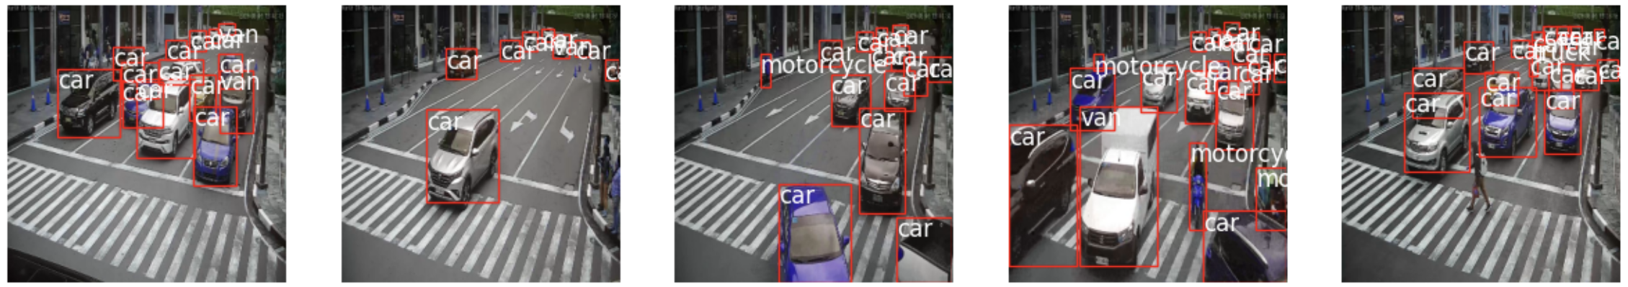
Training Images
Training
Label mapping
Cars, Vans, Motorcycles, etc…
Training images.
Bounding box incorporation for training images.
TensorFlow Record files generation and training.

Slide 12
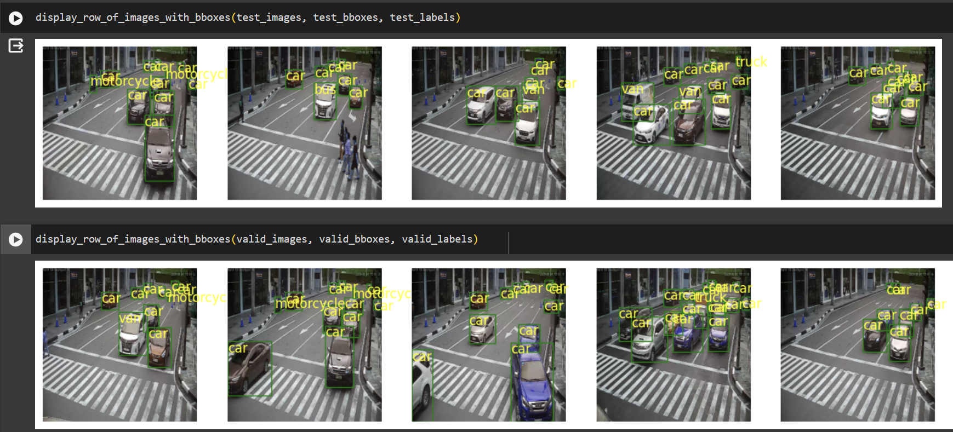
Result – Vehicle detection

Slide 13
Limitations
Pedestrian
detection
Ambulance and Firefighter detection
Output fitted to traffic control system
Training on human and bicycle detection
Count people waiting on the sidewalk to cross
Training the model with different types of ambulance to give priority pass at intersection.
Training the model with firetrucks too
Send information of vehicle count and compute comparations of other intersections

Slide 14
Contributions
Cesar Lucero
Nnamdi okeke
No third student assigned
Code co-development
Presentation build
Code co-development
Final Report build
Not applicable

Slide 15


Thank You
Nnamdi Okeke, Cesar Lucero nokeke@sandiego.edu, cluceroortiz@sandiego.edu

